Slide 1
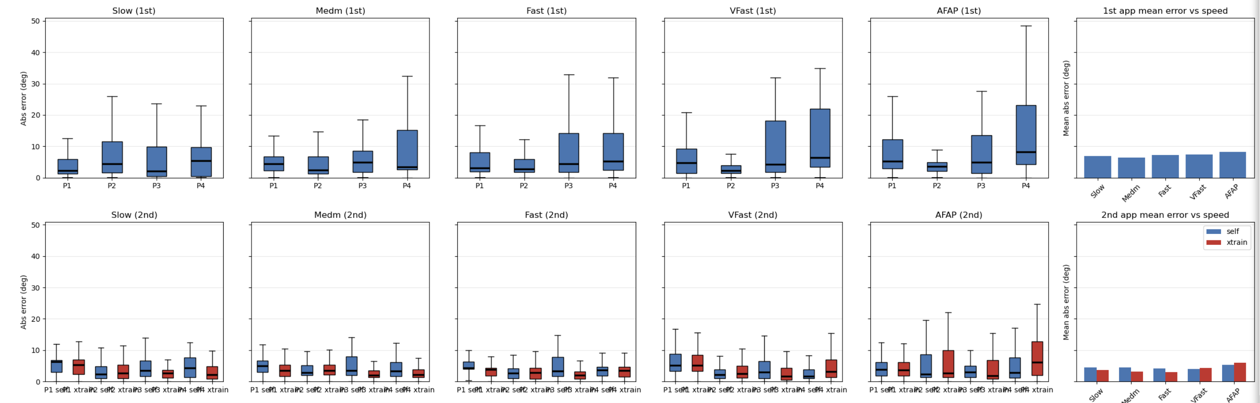
Strain Gauge Results:
Likelihood Threshold DLC Positions: 0.4 (increase this and number of pts in time series decreases)
Calibration angles: 0-> 67.5

Slide 2
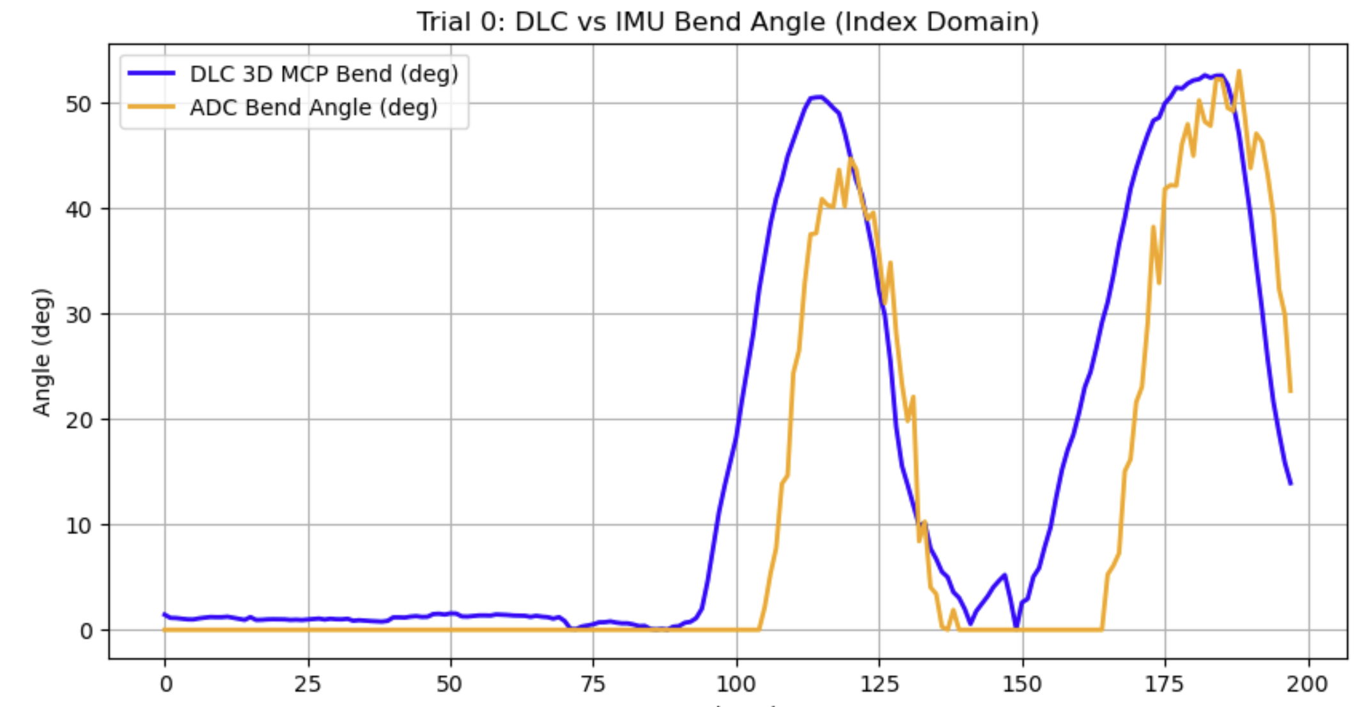
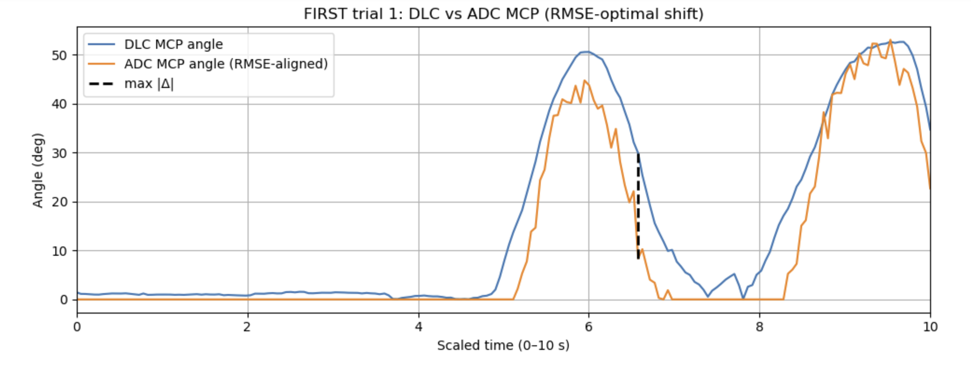
1st Alignment: Timestamp Alignment
2nd Alignment: Shift entire series until error is minimized

Slide 3
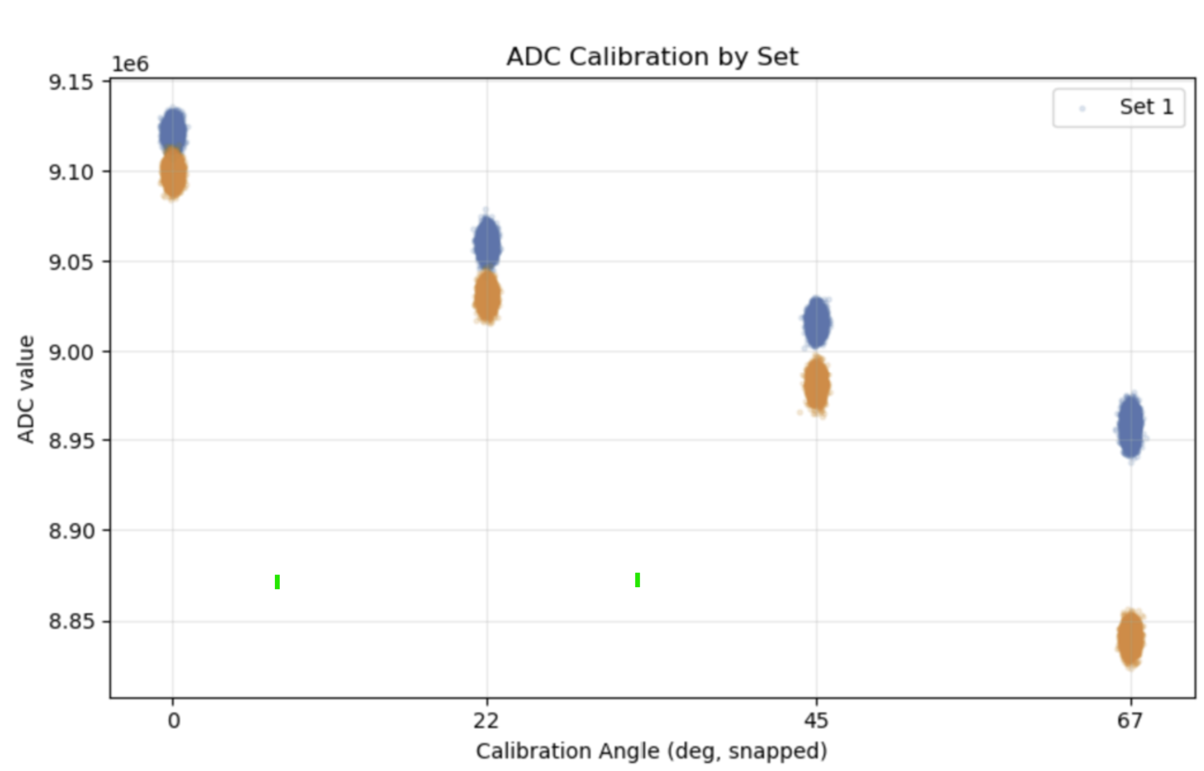
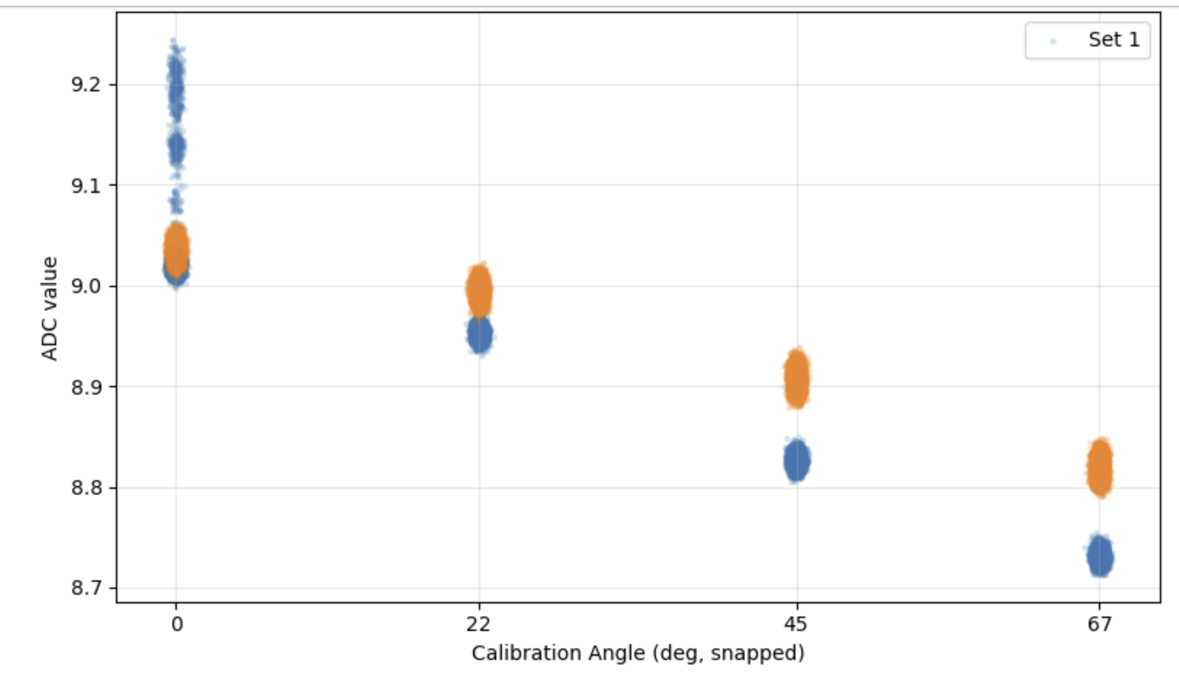
Strain Gauge Calibrations
Blue = 1st calibration
Orange = 2nd calibration
P3
P4

Slide 4
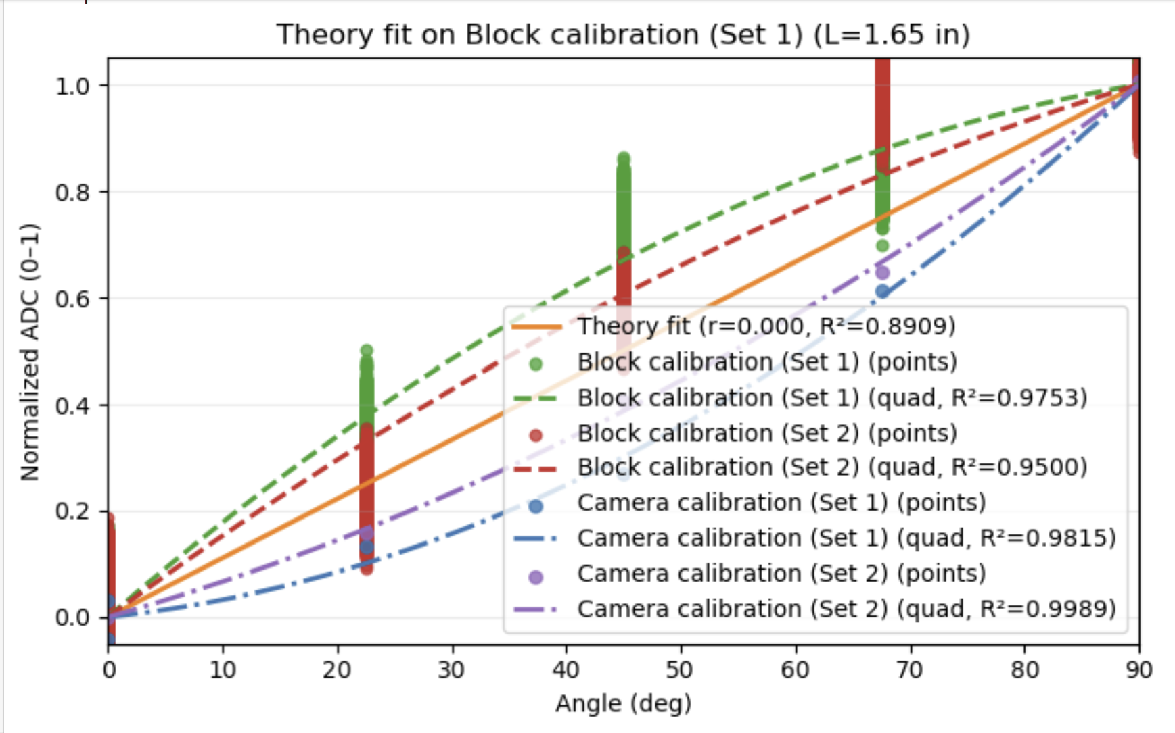

Slide 5
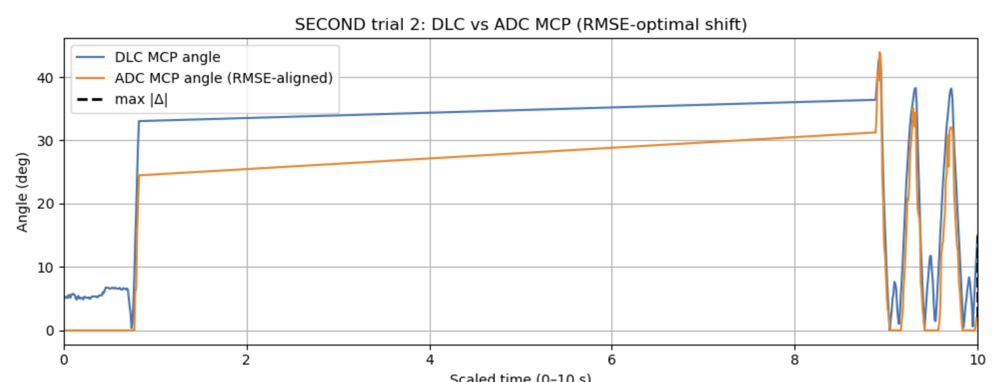
Occasionally saw this….disconnection?

Slide 6
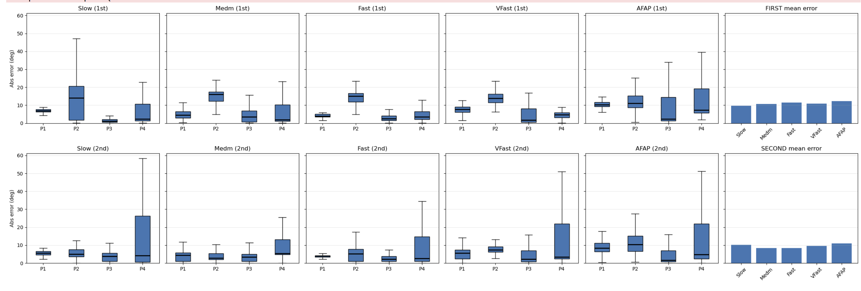
IMU Results:
Likelihood Threshold DLC Positions: 0.4
Angle calc:
Quaternions to rotation matrices.
change of basis for palm imu frame to wrist imu frame.
Calculate relative angle between vectors vwrist = [0 1 0] vs vpalm = [0 1 0] represented in wrist frame
Steel need to project palm vector to single plane (to get out flexion vs abduction)
Subtract baseline (starting IMU angle from time series so all angles start at 0 deg)

Slide 7
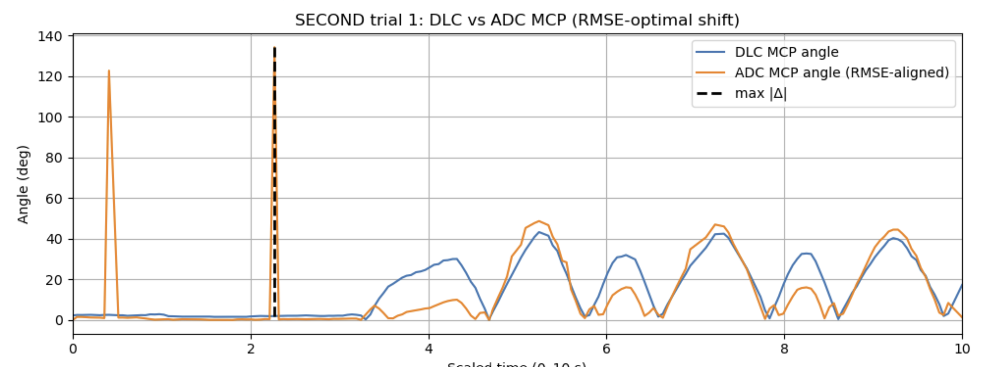

Slide 8
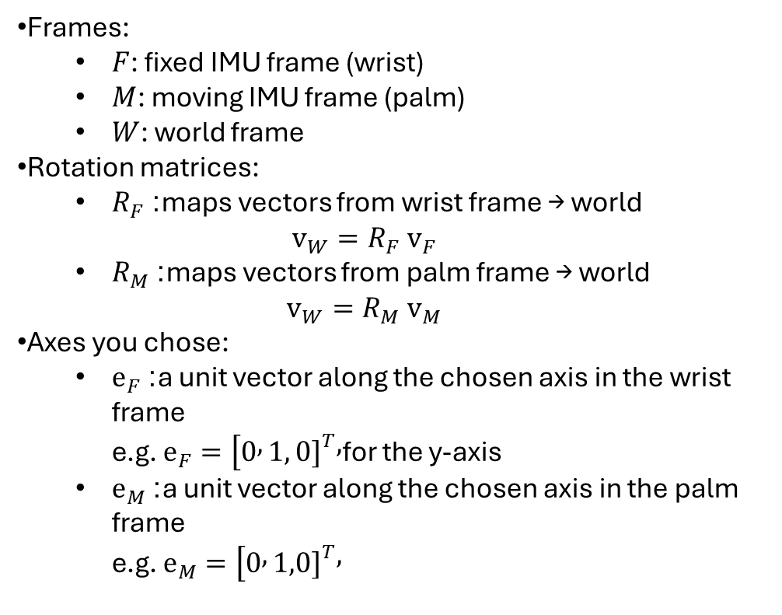
Frames:
  $F$: fixed IMU frame (wrist)
  $M$: moving IMU frame (palm)
  $W$: world frame
Rotation matrices:
  $R_{F}$: maps vectors from wrist frame → world
  $v_{W}=R_{F} v_{F}$
  $R_{M}$: maps vectors from palm frame → world
  $v_{W}=R_{M} v_{M}$
Axes you chose:
  $e_{F}$: a unit vector along the chosen axis in the wrist frame
  e.g. $e_{F}=[0 , 1, 0{\left.]\right.}^{T},$for the y-axis
  $e_{M}$: a unit vector along the chosen axis in the palm frame
  e.g. $e_{M}=[0 , 1,0{\left.]\right.}^{T},$

Slide 9
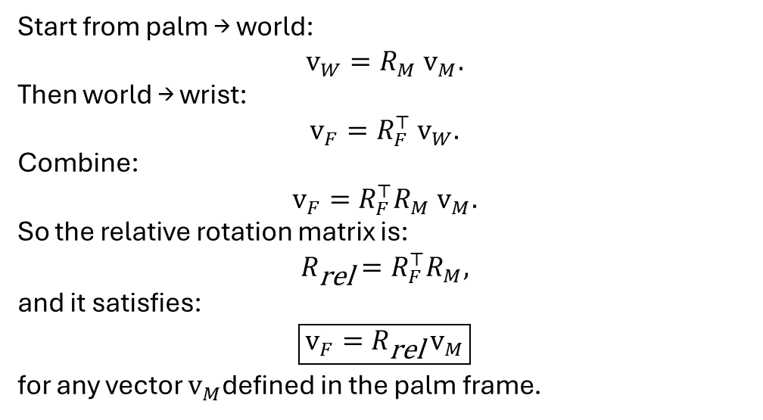
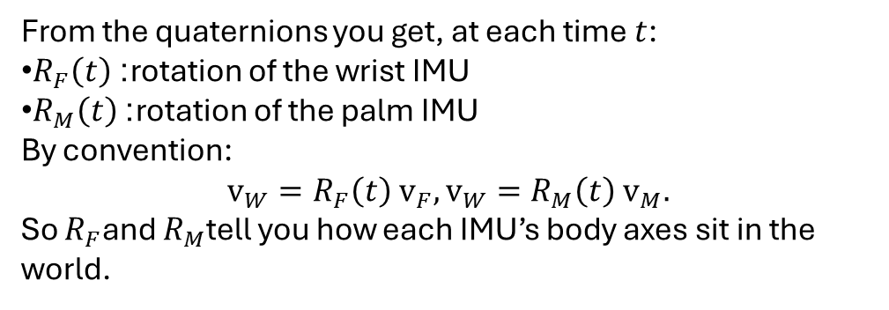
From the quaternions you get, at each time $t$:
$R_{F}\left(t\right)$: rotation of the wrist IMU
$R_{M}\left(t\right)$: rotation of the palm IMU
By convention:
$$v_{W}=R_{F}\left(t\right) v_{F}, v_{W}=R_{M}\left(t\right) v_{M}.$$
So $R_{F}$and $R_{M}$tell you how each IMU’s body axes sit in the world.
Start from palm → world:
$$v_{W}=R_{M} v_{M}.$$
Then world → wrist:
$$v_{F}=R_{F}^{⊤} v_{W}.$$
Combine:
$$v_{F}=R_{F}^{⊤}R_{M} v_{M}.$$
So the relative rotation matrix is:
$$R_{\text{rel}}=R_{F}^{⊤}R_{M},$$
and it satisfies:
$$\boxed{v_{F}=R_{\text{rel}} v_{M}}$$
for any vector $v_{M}$defined in the palm frame.

Slide 10
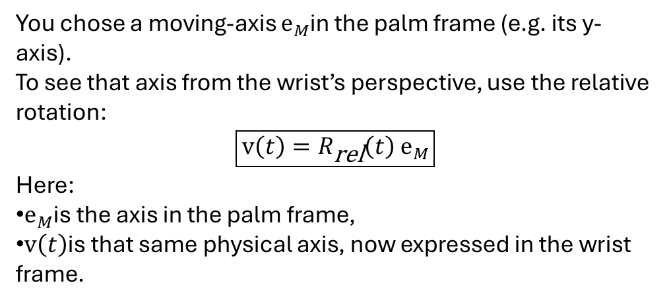
You chose a moving-axis $e_{M}$in the palm frame (e.g. its y-axis).
To see that axis from the wrist’s perspective, use the relative rotation:
$$\boxed{v\left(t\right)=R_{\text{rel}}\left(t\right) e_{M}}$$
Here:
$e_{M}$is the axis in the palm frame,
$v\left(t\right)$is that same physical axis, now expressed in the wrist frame.

Slide 11
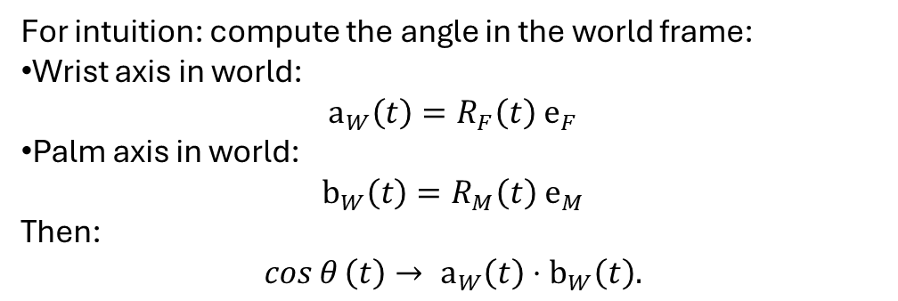
For intuition: compute the angle in the world frame:
Wrist axis in world:
$$a_{W}\left(t\right)=R_{F}\left(t\right) e_{F}$$
Palm axis in world:
$$b_{W}\left(t\right)=R_{M}\left(t\right) e_{M}$$
Then:
$$\cos{θ}\left(t\right)→ a_{W}\left(t\right)⋅b_{W}\left(t\right).$$

Slide 12
$$q_{1}=\left[{w_{1} x}_{1} y_{1} z_{1}\right]=wrist quaternion$$
$$q_{2}=\left[{w_{2} x}_{2} y_{2} z_{2}\right]=palm quaternion$$
$$q_{rel}=q_{1}^{−1}⨂q_{2}, where{ q}_{1}^{−1}=[{w_{1} −x}_{1} {−y}_{1} {−z}_{1}]$$
$θ_{rel pitch}=\sin^{−1}\left(2\left[w_{rel}y_{rel}−z_{rel}x_{rel}\right]\right)$
roll (X) = atan2( 2(w x + y z), 1 - 2(x² + y²) )
pitch (Y) = asin( 2(w y - z x) )
yaw (Z) = atan2( 2(w z + x y), 1 - 2(y² + z²) )
Kuipers, J. B. (1999). Quaternions and Rotation Sequences. Princeton University Press.
Chapter 5: Rotations, Relative Rotations, and Quaternion Algebra

